Slide 1
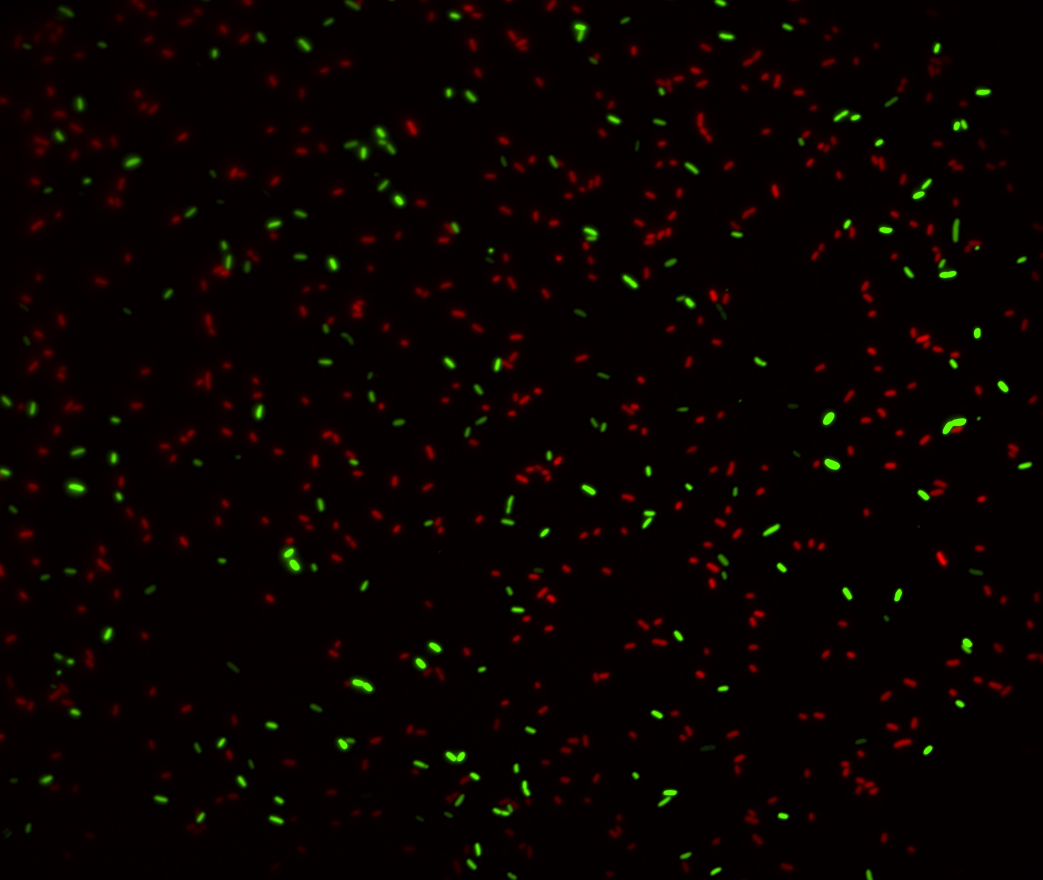
­­­­­The Evolution of Stress-Induced Mutagenesis
Yoav Ram Stanford University
Hebrew University of Jerusalem 13 December 2016

Slide 2
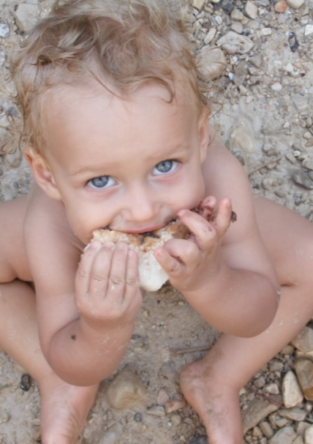
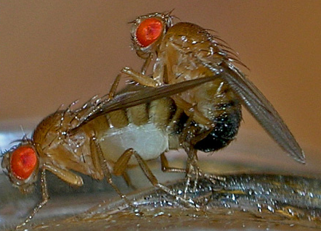
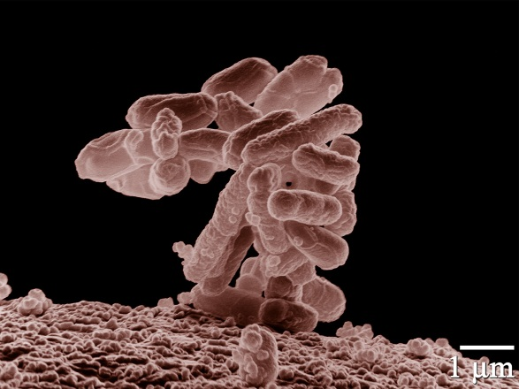
Variability in mutation rates
Between species
Average number of measurable mutations
per genome per generation
Flies: 0.455
Keightley et al. Gen Res 2009
Humans: 41
Lynch, PNAS 2010
Bacteria: 0.0004
Wielgoss et al. G3 2011

Slide 3
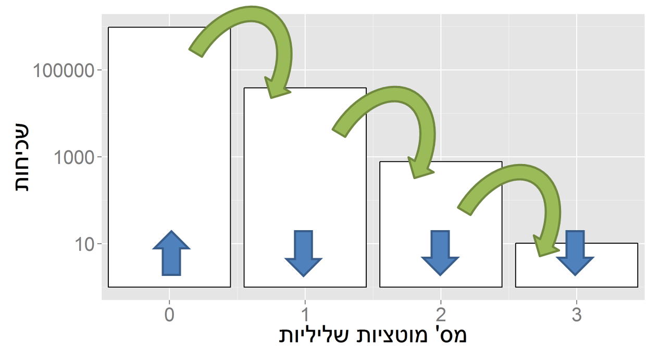
Evolution in a constant environment
Direction of selection doesn’t change
Balance between mutation and selection
Frequency
# Deleterious mutations

Slide 4
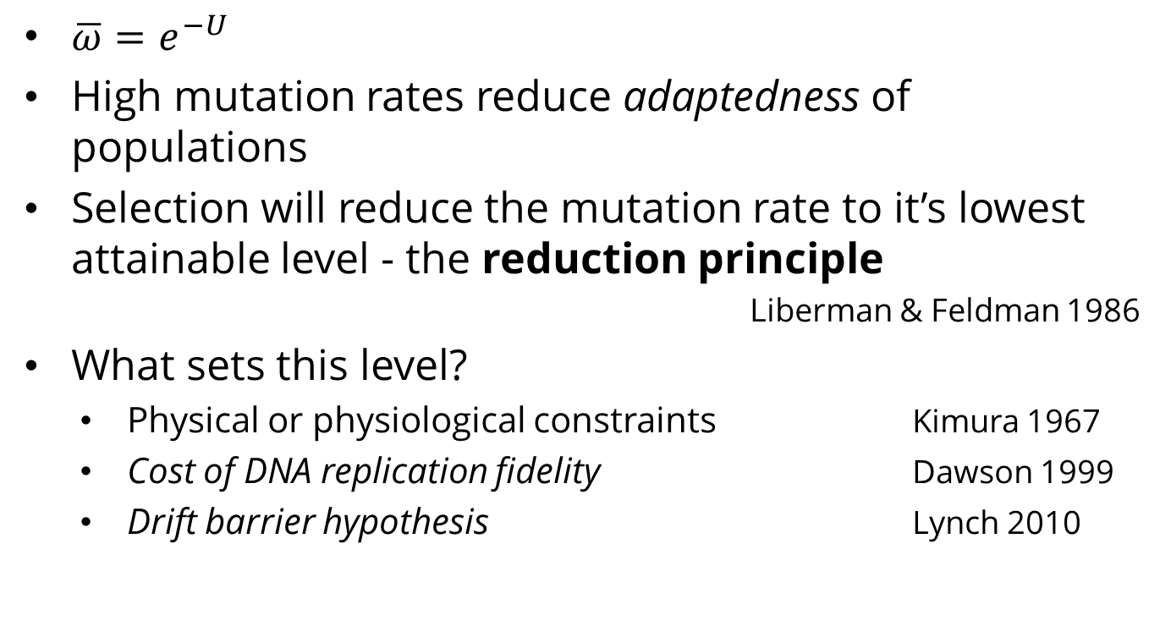
Mutation-selection balance
$\overline{ω}=e^{−U}$
High mutation rates reduce adaptedness of populations
Selection will reduce the mutation rate to it’s lowest attainable level - the reduction principle
Liberman & Feldman 1986
What sets this level?
Physical or physiological constraints Kimura 1967
Cost of DNA replication fidelity Dawson 1999
Drift barrier hypothesis Lynch 2010

Slide 5

Evolution in a changing environment
In changing environments rapid adaptation can be favored by natural selection
The mutation rate must balance between adaptability and adaptedness
Leigh 1973

Slide 6
Variability in mutation rates
Within species
Mutation rate in 69 natural populations of E. coli
Matic et al. 1997

Slide 7
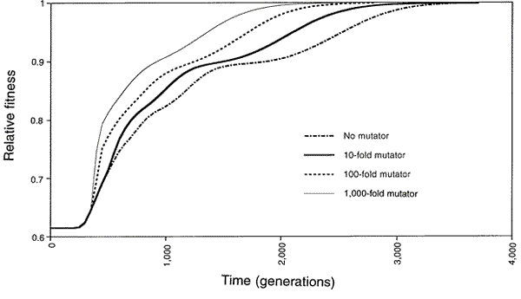
Adaptation with mutator alleles
x100
x10
x1
x1,000
Taddei, et al. Nature 1997

Slide 8
Variability in mutation rates
Within individuals
DNA polymerase error rate Lynch 2011

Slide 9
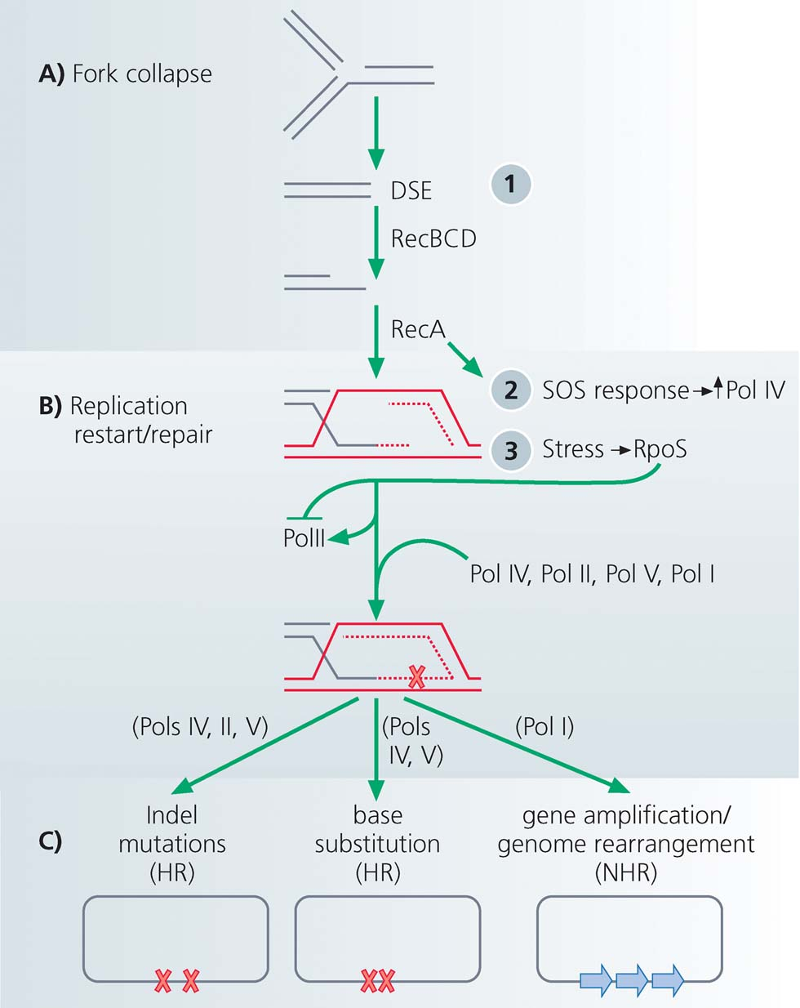
Stress-induced mutagenesis
Rosenberg et al. 2012
In E. coli:
Error prone polymerase induced by stress responses:
SOS response
DNA damage
Starvation
Mismatch repair system
Other mechanisms:
Galhardo et al. 2007
Al Mamun, Science 2012
High-fidelity polymerase
Error-prone polymerases

Slide 10
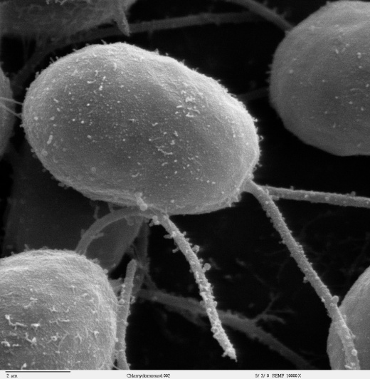
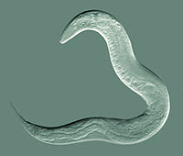
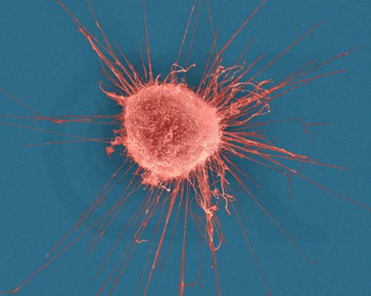

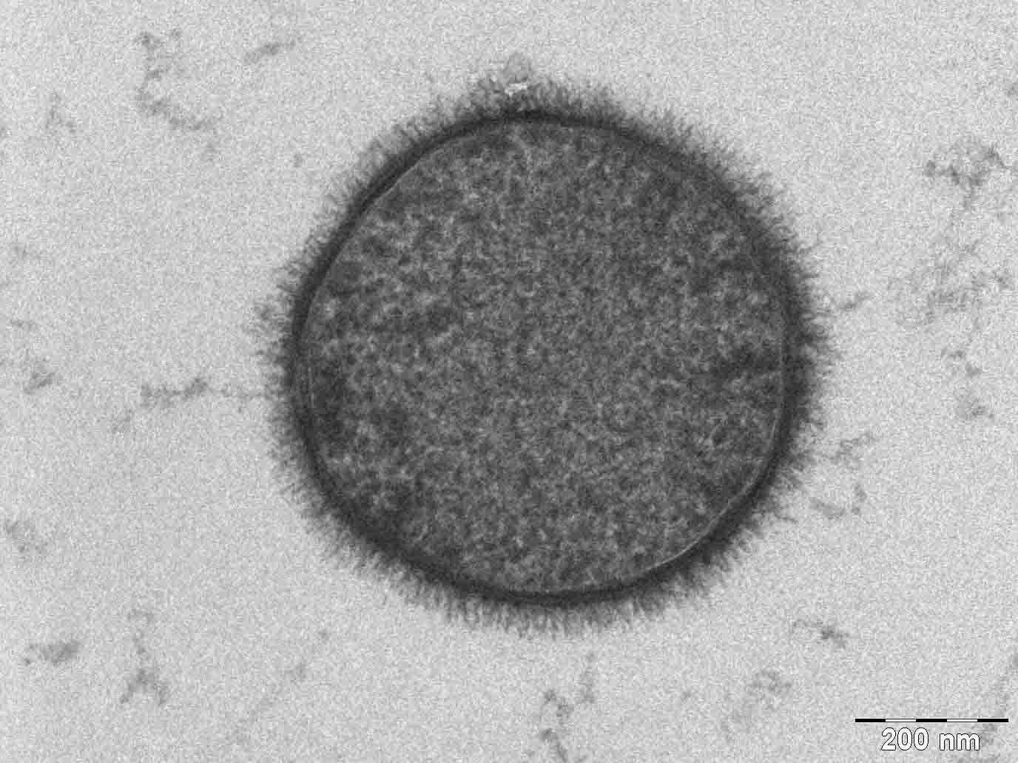
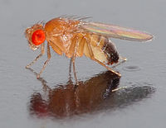
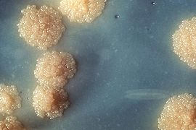
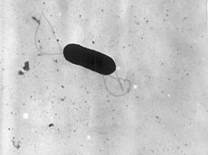
Evidence
Green algea
Nematodes
E. coli
Bacillus subtilis
Breast cancer cell
D. Melanogaster
M. tuberculosis
L. monocytogenes

Slide 11
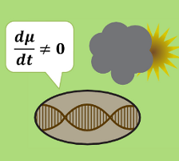
Evolution of stress-induced mutagenesis
Null hypothesis
Mutagenesis is the by-product of stress
Alternative non-adaptive hypotheses
Cost of replication fidelity
Adaptive hypothesis
2nd order selection

Slide 12
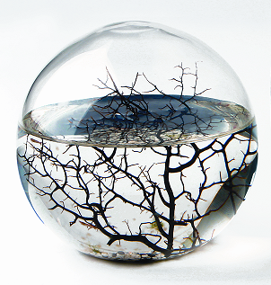
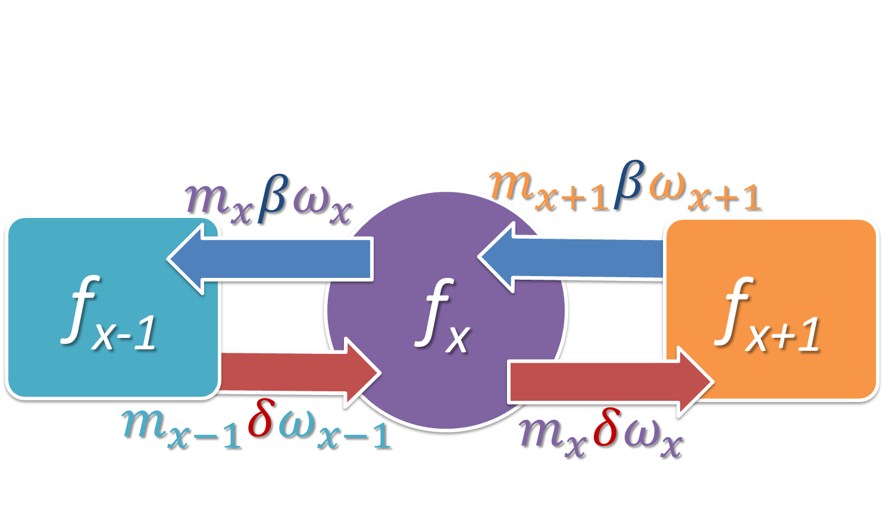
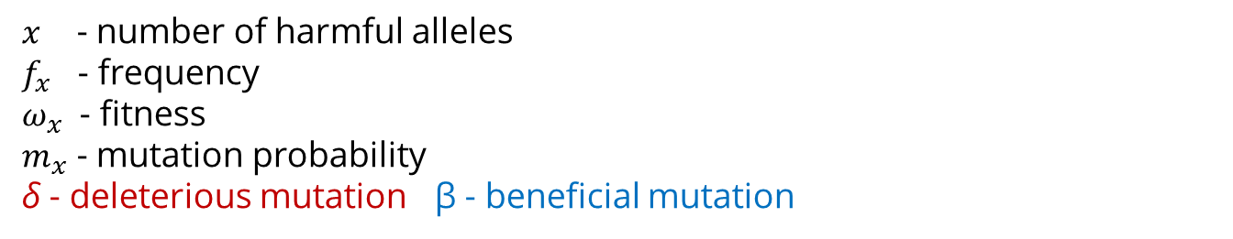
Constant environment
Selection against generation of deleterious mutations
$x$ - number of harmful alleles
$f_{x}$ - frequency
$ω_{x}$ - fitness
$m_{x}$ - mutation probability
δ - deleterious mutation β - beneficial mutation
Ram & Hadany, Evolution 2012

Slide 13
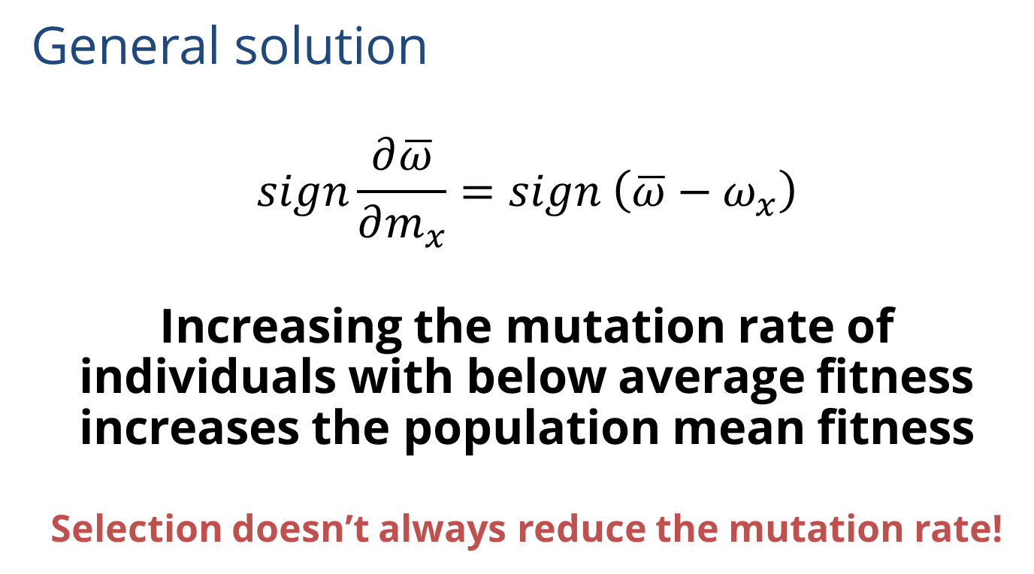
Constant environment
General solution
$$sign\frac{∂\overline{ω}}{∂m_{x}}=sign \left(\overline{ω}−ω_{x}\right)$$
Increasing the mutation rate of individuals with below average fitness increases the population mean fitness
Selection doesn’t always reduce the mutation rate!
Ram & Hadany, Evolution 2012

Slide 14

Changing environments
The Red Queen hypothesis
van Valen, 1973
It takes all the running you can do,
to keep in the same place.
- Lewis Carrol, Through the Looking Glass
What happens when the environment changes frequently?

Slide 15

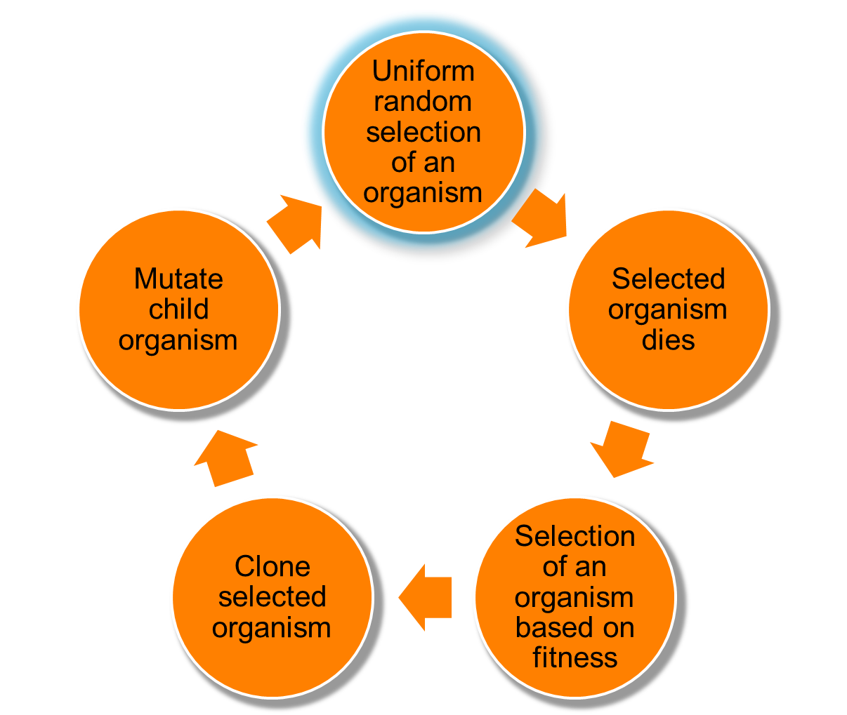
Changing environments
github.com/yoavram/proevolutionsimulation
Simulations
Moran process
Individual-based simulations
100,000 individuals
1,000 loci
Asexual, Haploid
Overlapping generations
No recombination
No segregation
No mutations at mutator locus
Environmental changes
Ram & Hadany, Evolution 2012

Slide 16
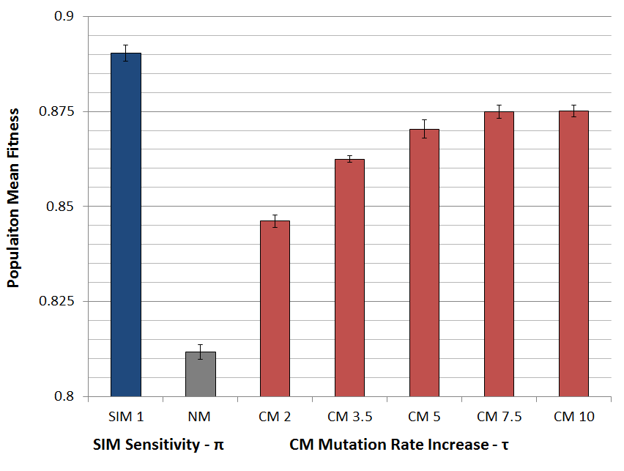
Populations with SIM are fitter
Ram & Hadany, Evolution 2012

Slide 17
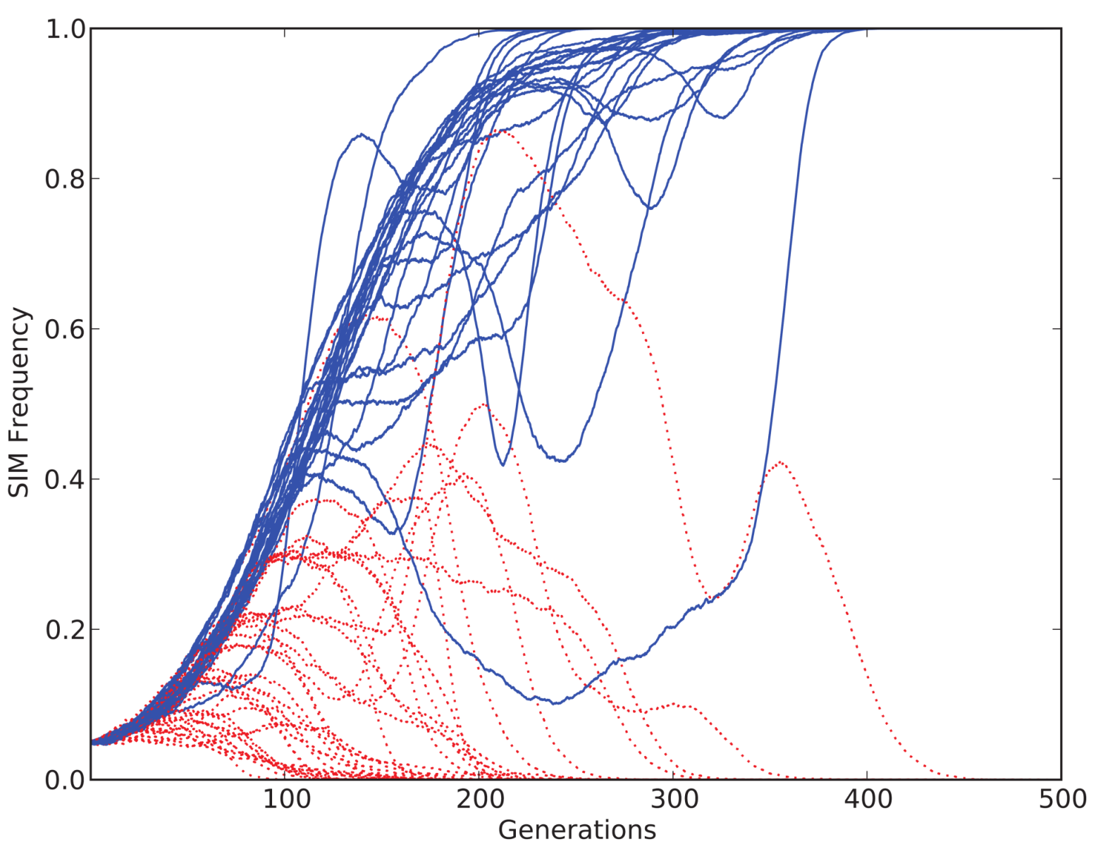
SIM wins competitions
Ram & Hadany, Evolution 2012

Slide 18
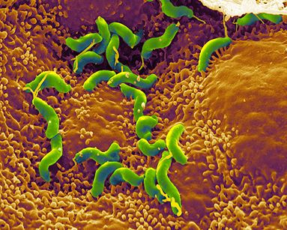
Conclusions
Stress-induced mutators evolve:
In constant & changing environments
2nd order selection can lead to the evolution of stress-induced mutagenesis in asexual populations
Selection for evolvability
H. pylori

Slide 19
In the presence of recombination
Recombination can:
Separate mutator from beneficial mutations
Increase non-mutator adaptation rate
Save constitutive mutators from deleterious mutations

Slide 20
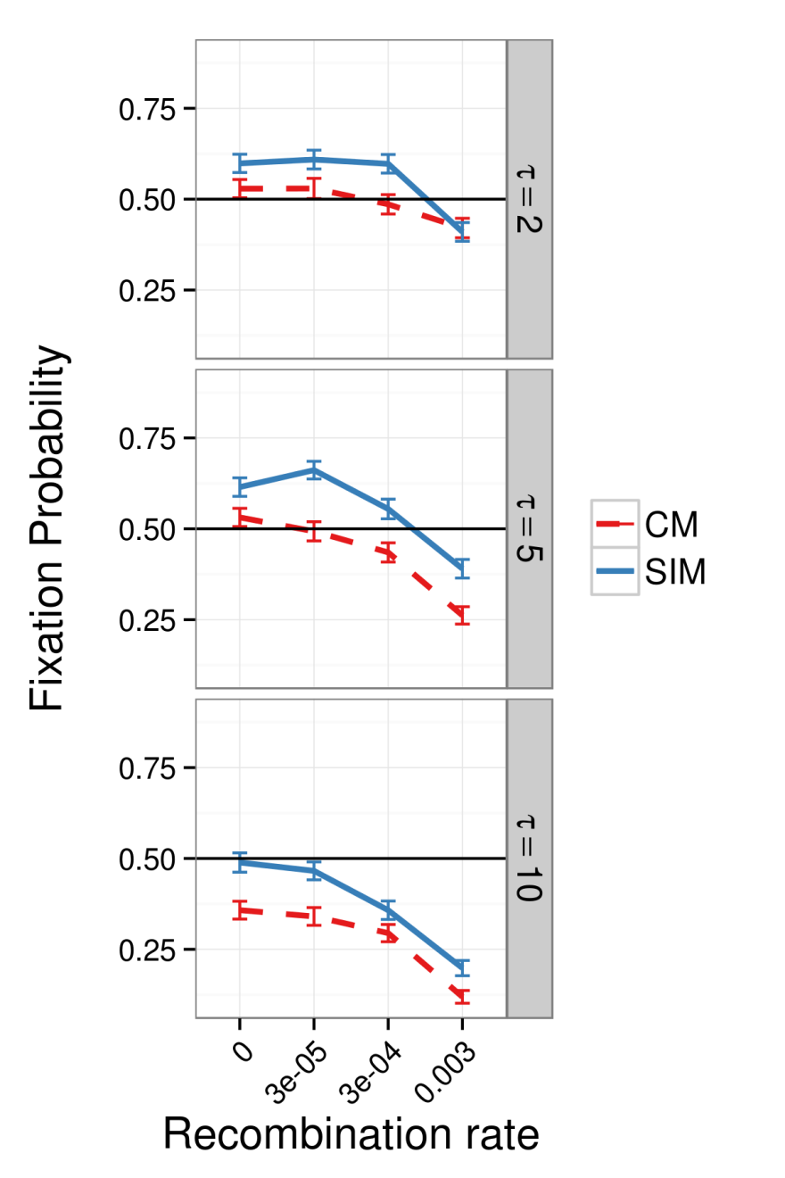
In the presence of recombination
Results suggest:
SIM > CM
SIM >= NM
As long as recombination is as not much stronger than mutations
Sexual populations??
Ram & Hadany, in preparation
Ram & Hadany, in preparation

Slide 21
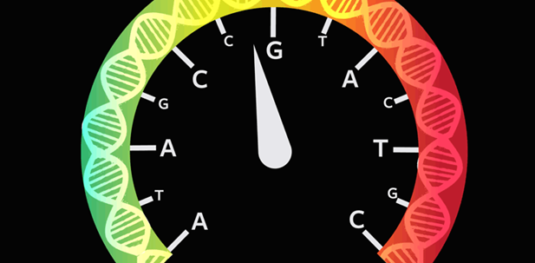
Consequences of Stress-Induced Mutagenesis
How does stress-induced mutagenesis affect adaptation?
http://nautil.us/issue/34/adaptation/does-stress-speed-up-evolution

Slide 22
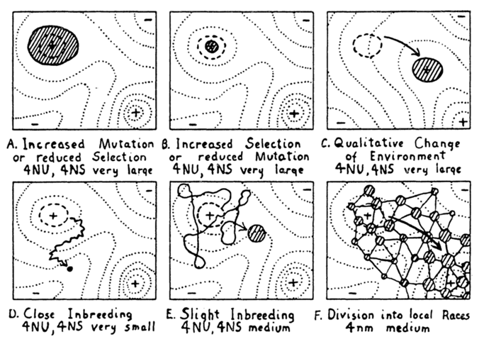
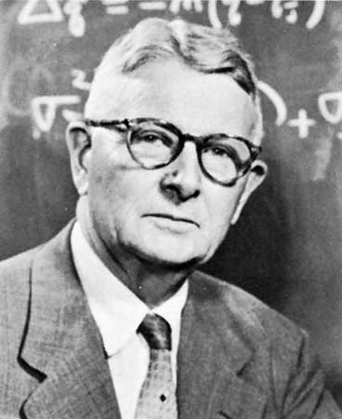
Adaptive peak shifts
Sewall Wright, 1931:
If a new adaptation requires several, separately deleterious mutations, how can it evolve?
Wright, Am. Nat. 1988

Slide 23
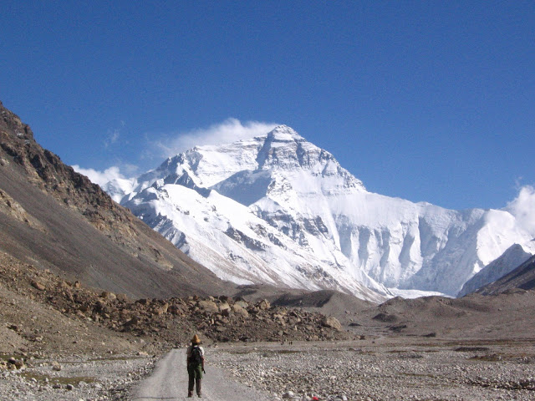
Simple landscape

Slide 24
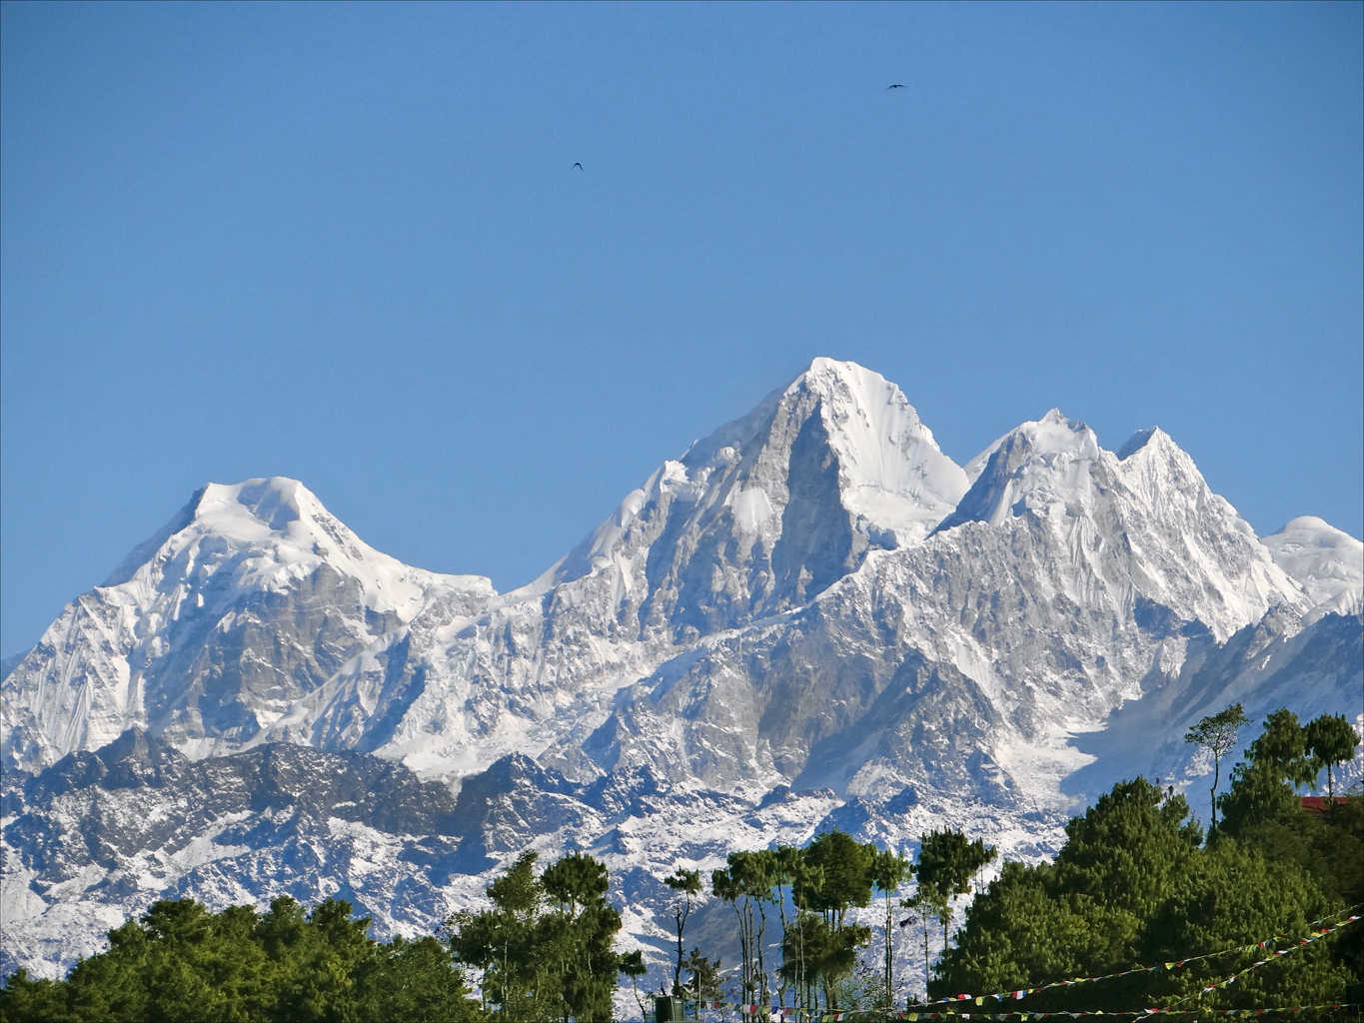
Rugged landscape

Slide 25
Adaptive peak shift

Slide 26
SIM & rugged landscapes
Increasing the mutation rate in individuals below both peaks
High mutation rate
Low mutation rate

Slide 27
Model
github.com/yoavram/ruggedsim
Ram & Hadany, PRSB 2014

Slide 28
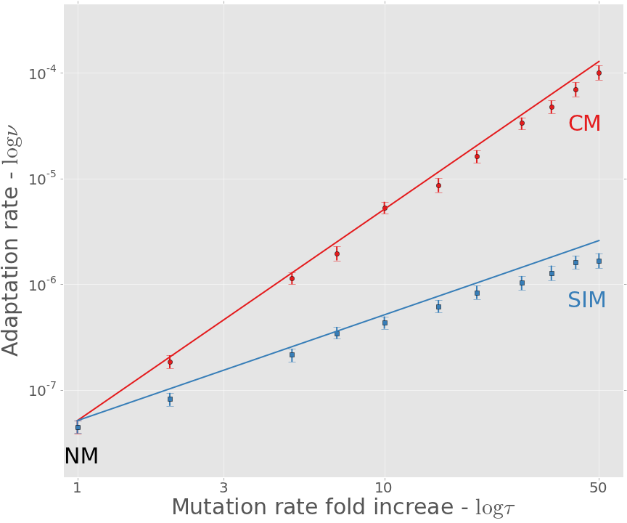

Adaptation rate
github.com/yoavram/ruggedsim
$$ν_{CM}≈τ^{2}∙ν_{NM}$$
$$ν_{SIM}≈τ∙ν_{NM}$$
Approximation
Simulation
Ram & Hadany, PRSB 2014

Slide 29
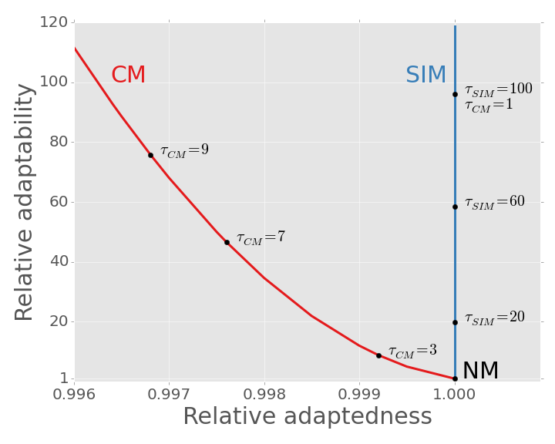
SIM Breaks the adaptability-adaptedness trade-off
Ram & Hadany, PRSB 2014

Slide 30
Conclusions
Effects of stress-induced mutagenesis:
SIM increases the adaptation rate without reducing the population mean fitness
Breaks the trade-off between adaptability and adaptedness
Ram & Hadany, PRSB 2014

Slide 31
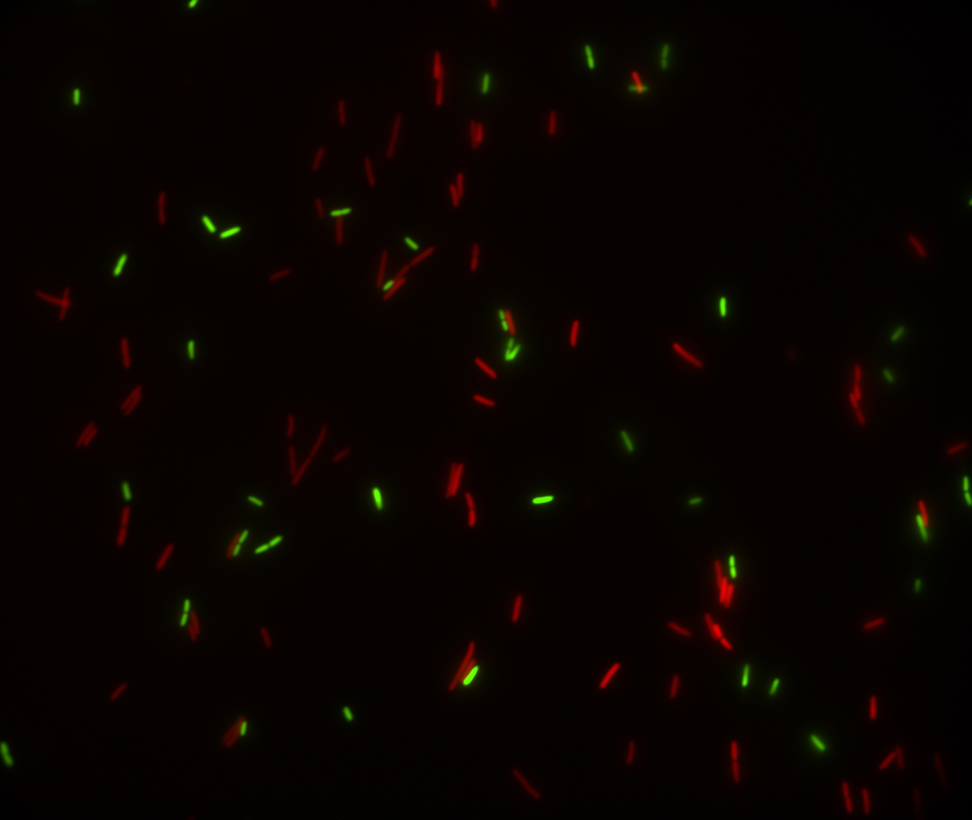
Predicting Microbial Growth in a Mixed Culture

Slide 32
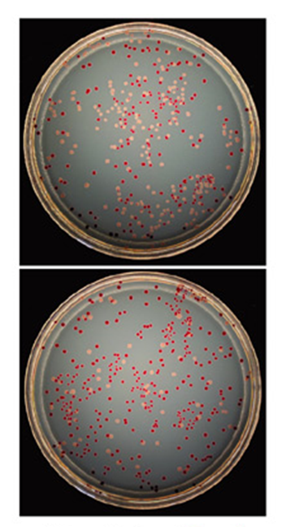
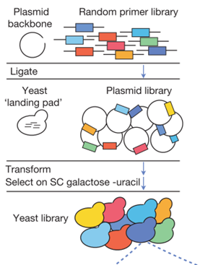
Competition experiments
Strains must have a genotypic or phenotypic marker.
Problem: Laborious and costly, more so for non-model organisms.
Our Solution: Computational framework that predicts growth in mixed culture:
Fit growth models to growth curves
Predict competition results
Infer fitness
Ara⁻
Ara⁺

Slide 33
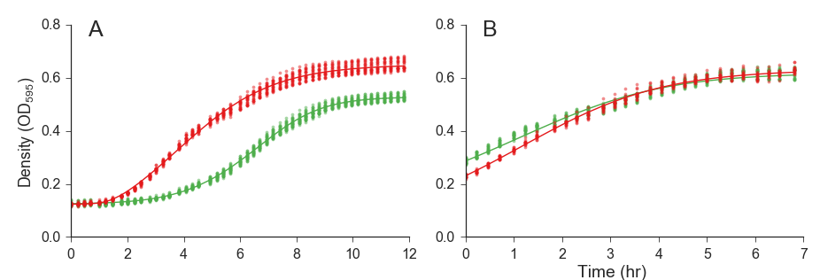
Growth curve data
Data from two experiments with E. coli strains: (DH5α vs. TG1) fitted a growth model
Baranyi & Roberts, 1994
with lag phase
without lag phase

Slide 34
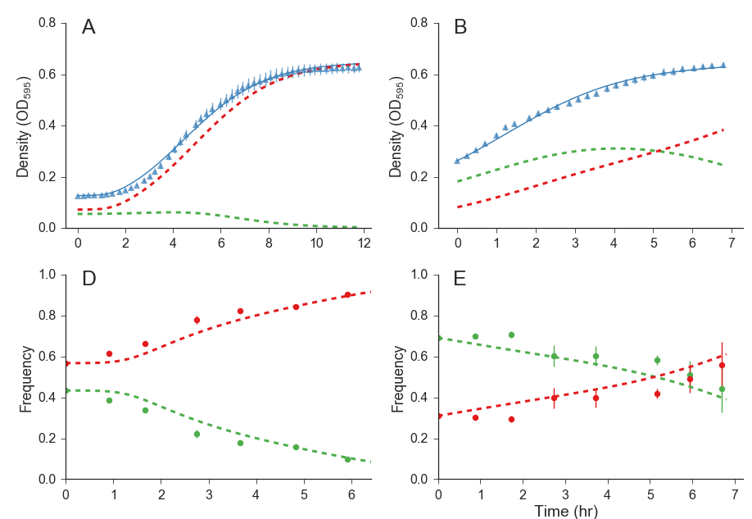

Mixed culture prediction

Slide 35
Summary
Fit growth models to growth curves
Predict competition results
Infer fitness
Preprint:
Ram et al. (2015) Predicting microbial relative growth in a mixed culture from growth curve data. bioRxiv, doi:10.1101/022640
Software website: curveball.yoavram.com

Slide 36
Future directions
Complex growth curves:
Bi-phasic growth:
Deep stationary phase
Cell death
Null model for detection of frequency-dependent interactions:
Cooperation
Interference
Compete hypothetical strains
Predict adaptive evolution
Interpret fitness differences

Slide 37
Summary
Stress-induced mutagenesis
Can evolve due to 2nd order selection
In constant & changing environments
In asexual populations
Ram & Hadany, Evolution 2012
In the presence of rare recombination
Ram & Hadany, in preparation
Increases the rate of complex adaptation rate
Without reducing the population mean fitness
Breaks the trade-off between adaptability and adaptedness
Ram & Hadany, PRSB 2014
Predicting microbial growth in a mixed culture
Ram et al., bioRxiv preprint

Slide 38








Acknowledgments
Lilach Hadany*
Uri Obolski*
Eynat Dellus-Gur*
Ariel Gueijman
Eyal Zinger
Itzhak Khait
Ohad Lewin-Epstein
Marine Veits
Michael Fishman
Judith Berman*
Maayan Bibi*
Ella Shtifman Segal
Noa Wertheimer
Alex Rosenberg
Adi Zisman
Feng Yang
Yitzhak Pilpel
Orna Dahan
Dorit Hizi
Itamar Françoise
Idan Frumkin
Avihu Yona
Avigdor Eldar
Ishay Ben-Zion
Eran Even-Tov
Contact
Israeli Ministry
of Science & Technology
yoav@yoavram.com
@yoavram
github.com/yoavram
www.yoavram.com
The Anat Karuskopf Fund


